Slide 1
Victoria Watson
In this project I learned how to display images in different projections. I learned how to apply different projections to a world map in QGIS by searching the EPSG and how to overlay the respective Indicatrix Mapper to analyze the distortion that each projection has.

Slide 2
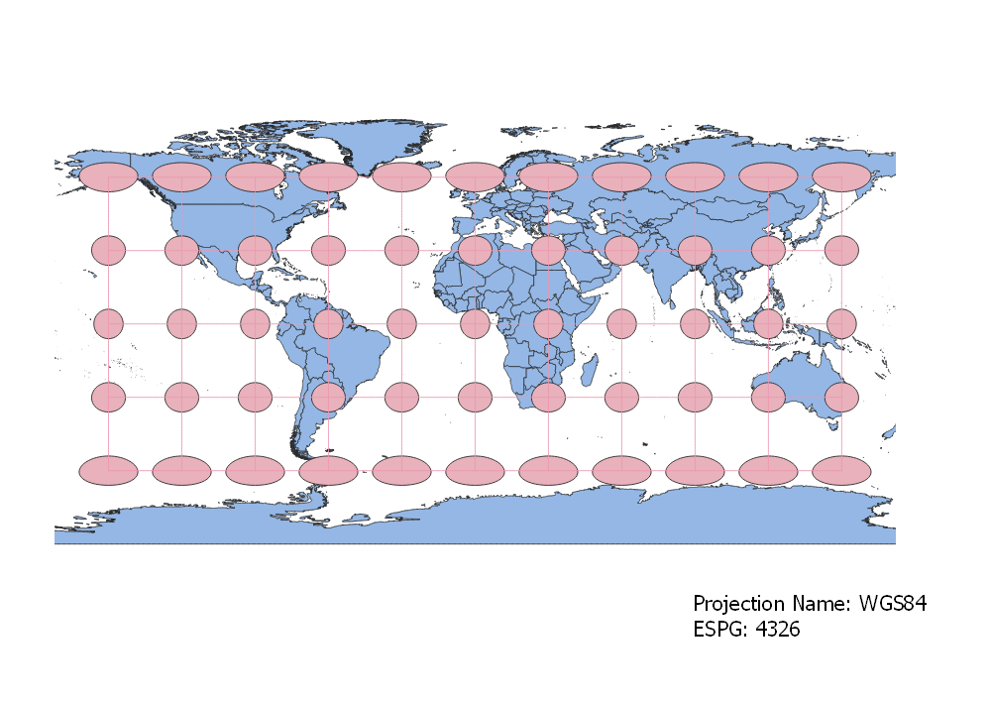
WGS84 Projection
This projection distorts area, creating larger looking poles. The circles however, maintain their shape for the most part. This projection maintains shape but distorts size. The poles appear much bigger and a little more squished than in reality.
This is a Mercator map that comes from a cylindrical projection.

Slide 3
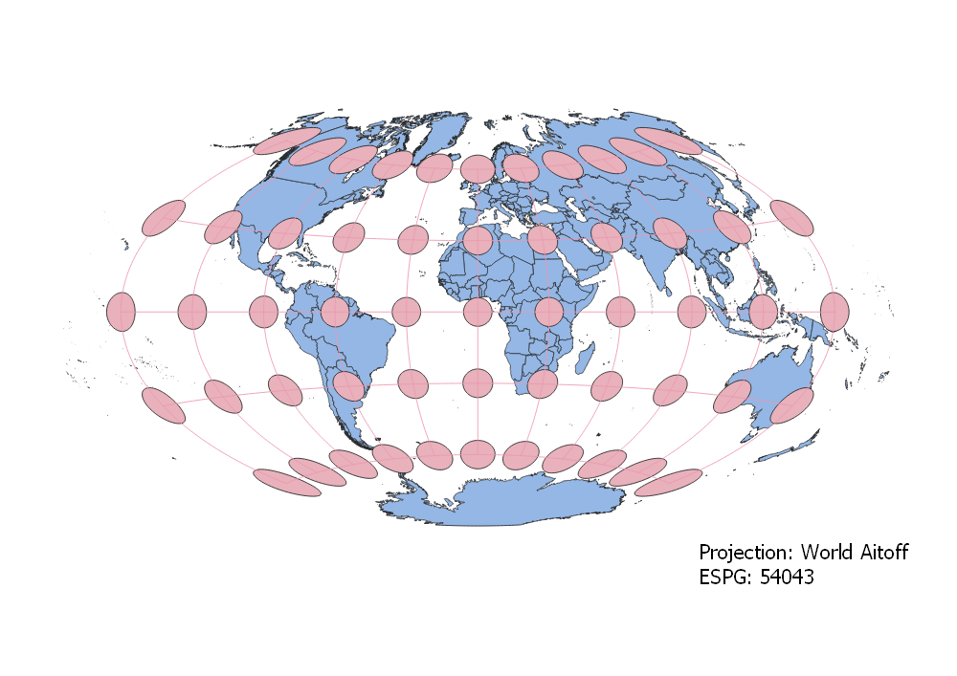
Aitoff Projection
The Aitoff projection is based on an azimuthal map.
As distance grows from the center point of the map, distortion of size and shape increases as well.
The poles are more elongated and larger than normal.

Slide 4
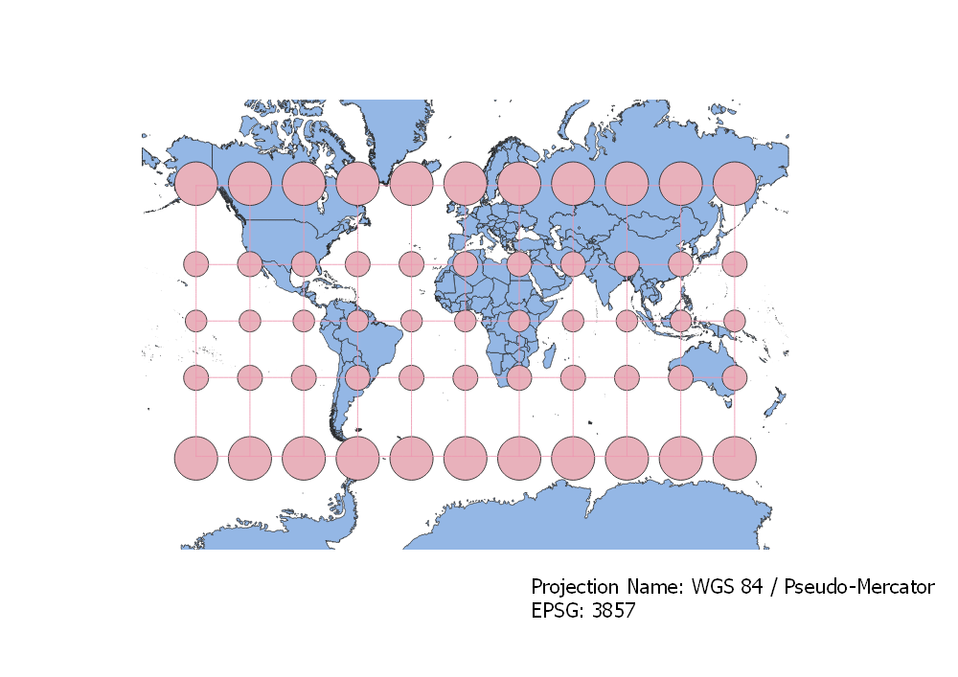
WGS84/Pseudo Mercator Projection
Similarly to the WGS 84 projection, this Pseudo Mercator map is a cylindrical projection.
Because the Tissot circles remain circular across the map but differ in size, we know that this projection distorts the poles in area, making them look much bigger than they are, but maintains the shape pretty well.

Slide 5
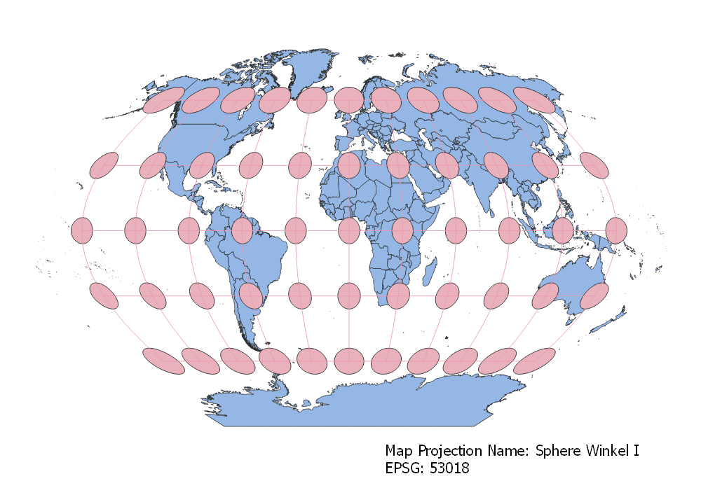
Sphere Winkel I Projection
The Winkel I projection seems to balance the distortion between both shape and size. The poles are a bit larger than normal but not as bad as the WGS 84 projection.
This map comes from a pseudo cylindrical projection.

Slide 6
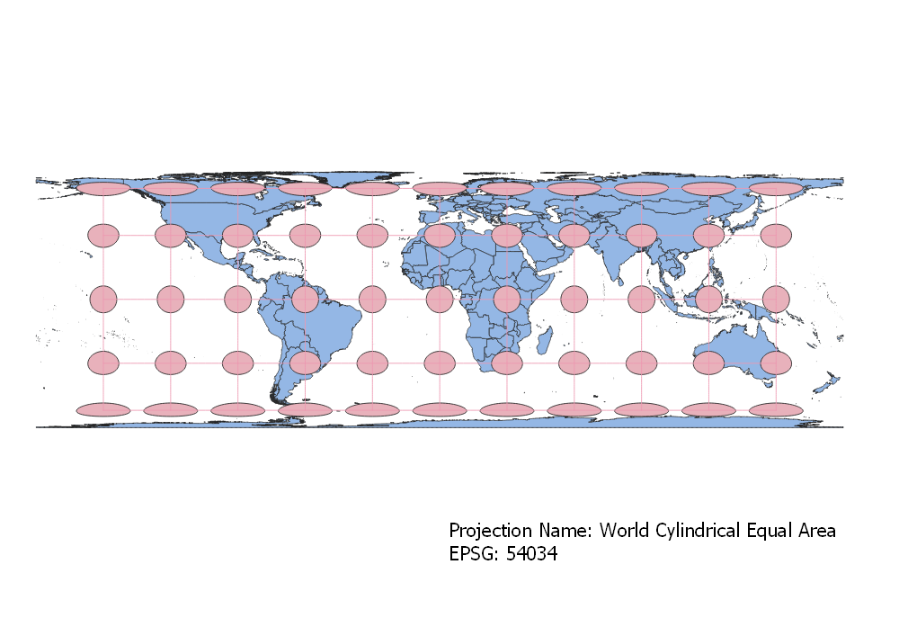
World Cylindrical Equal Area Projection
This projection is a cylindrical projection. One signal of this is that the latitudinal and longitudinal lines are perpendicular to one another.
The poles are larger than usual and horizontally elongated. The center latitudes maintain shape and size pretty well.

Slide 7
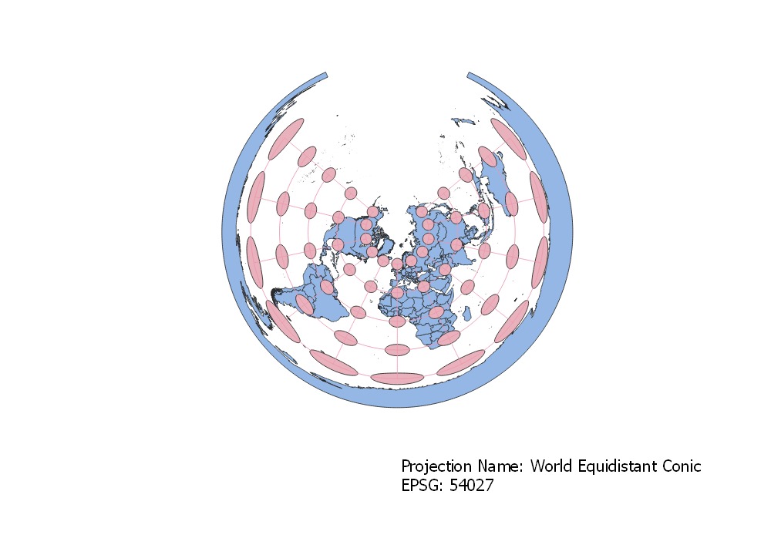
World Equidistant Conic Projection
This is a conic projection. All longitudinal lines converge to the center point of the map. As distance increases from that center point, there is noticeable distortion of both size and shape, becoming larger and more elongated.

Slide 8
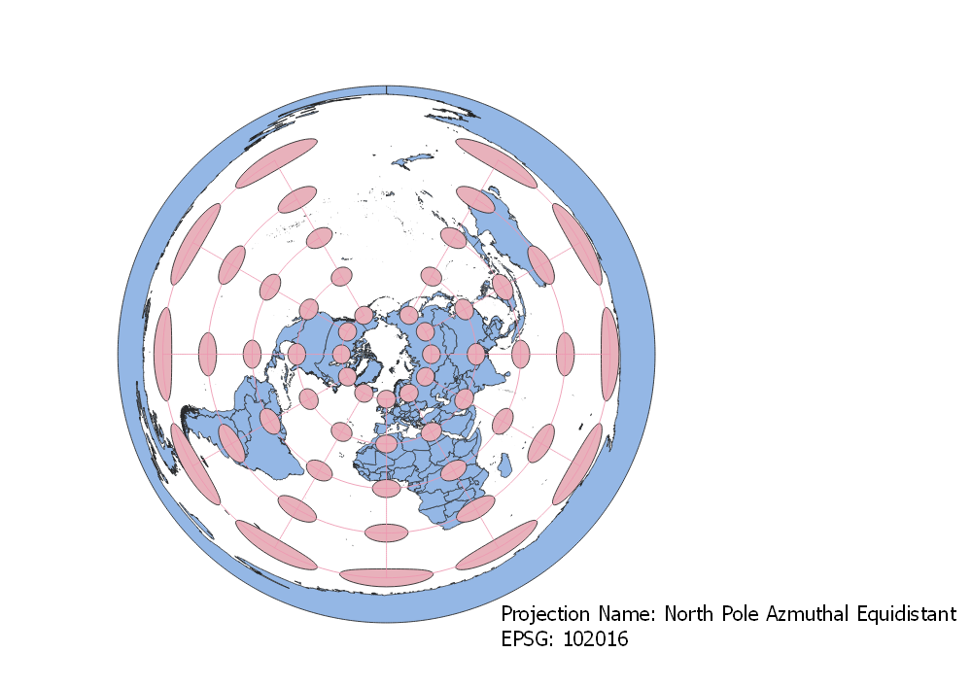
North Pole Azimuthal Equidistant Projection
This is an azimuthal projection. Distortion happens as distance increases from the center of the map. In this case the south pole is very large and very stretched out. The center point represents a pretty accurate projection in terms of area and shape.

Slide 9
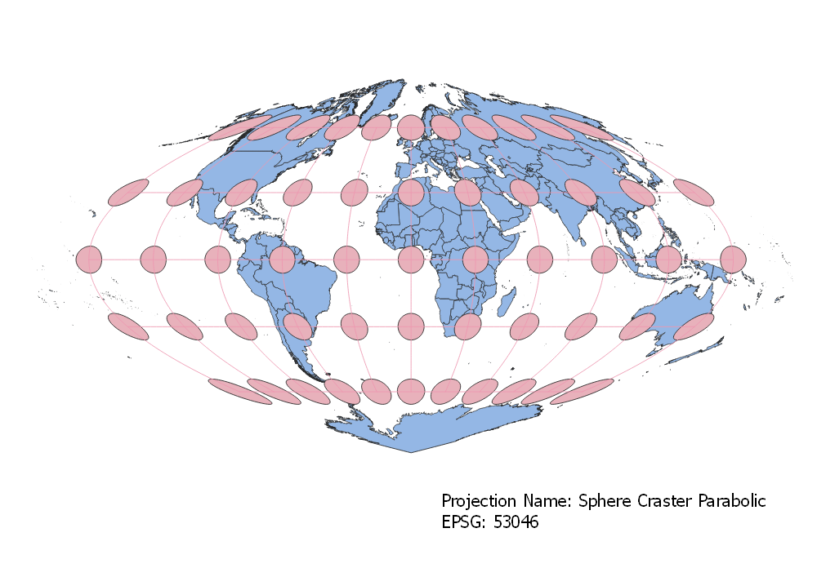
Sphere Craster Parabolic
This is a pseudo cylindric projection.
This projection behaves similarly to the Mercator projections although there is a bit more distortion of shape in addition to size as you reach the poles rather than just the size.

Slide 10
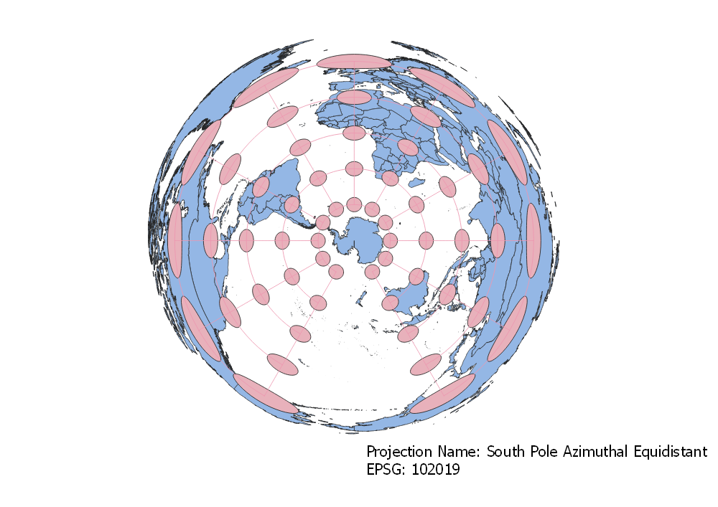
South Pole Azimuthal Equidistant
This is an example of an azimuthal projection.
This is the opposite view of the North Pole Azimuthal Equidistant projection. This projection distorts the north pole and retains the area and shape of the south pole and gradually projects larger and more horizontally stretched as distance increases from the south pole (center of map).

